Slide 1
CS 241 — Final Project
By: Solomon Himelbloom (Spring 2021)

Slide 2
Bear Aware Smart Latch
🔗 https://github.com/TechSolomon/cs241

Slide 3
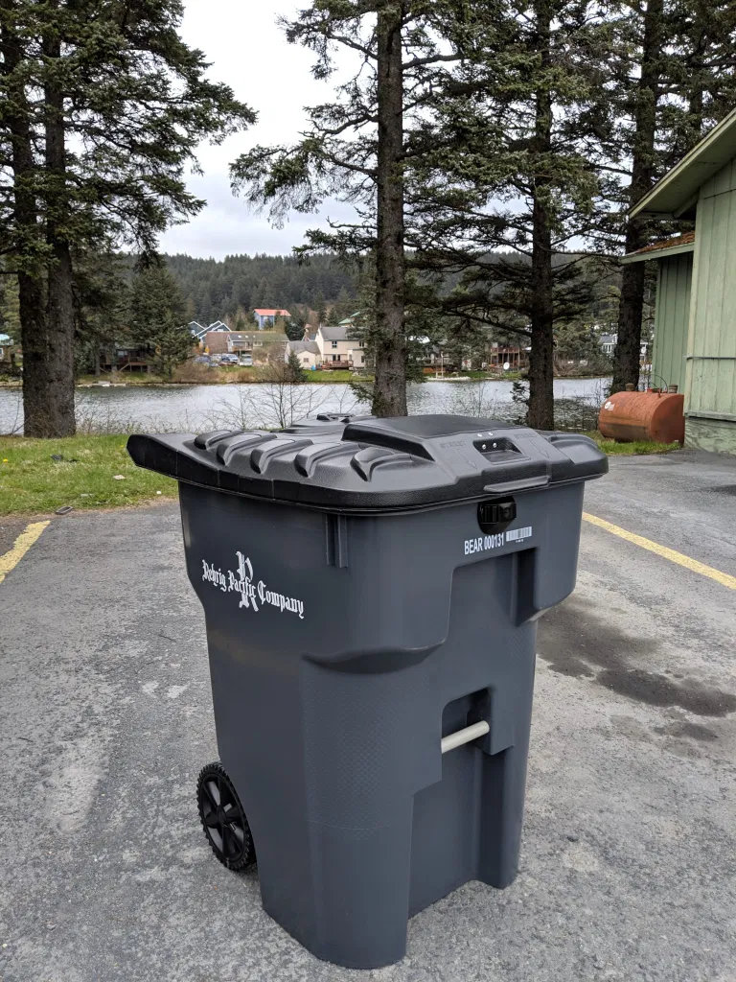
Initial Idea & Problem Statement
Secure outdoor trash cans (roll carts) against bears
Record wildlife interactions with humans in Alaska
Alert owner about intruders since last visit
Image Credit: KMXT (Kodiak, Alaska)

Slide 4
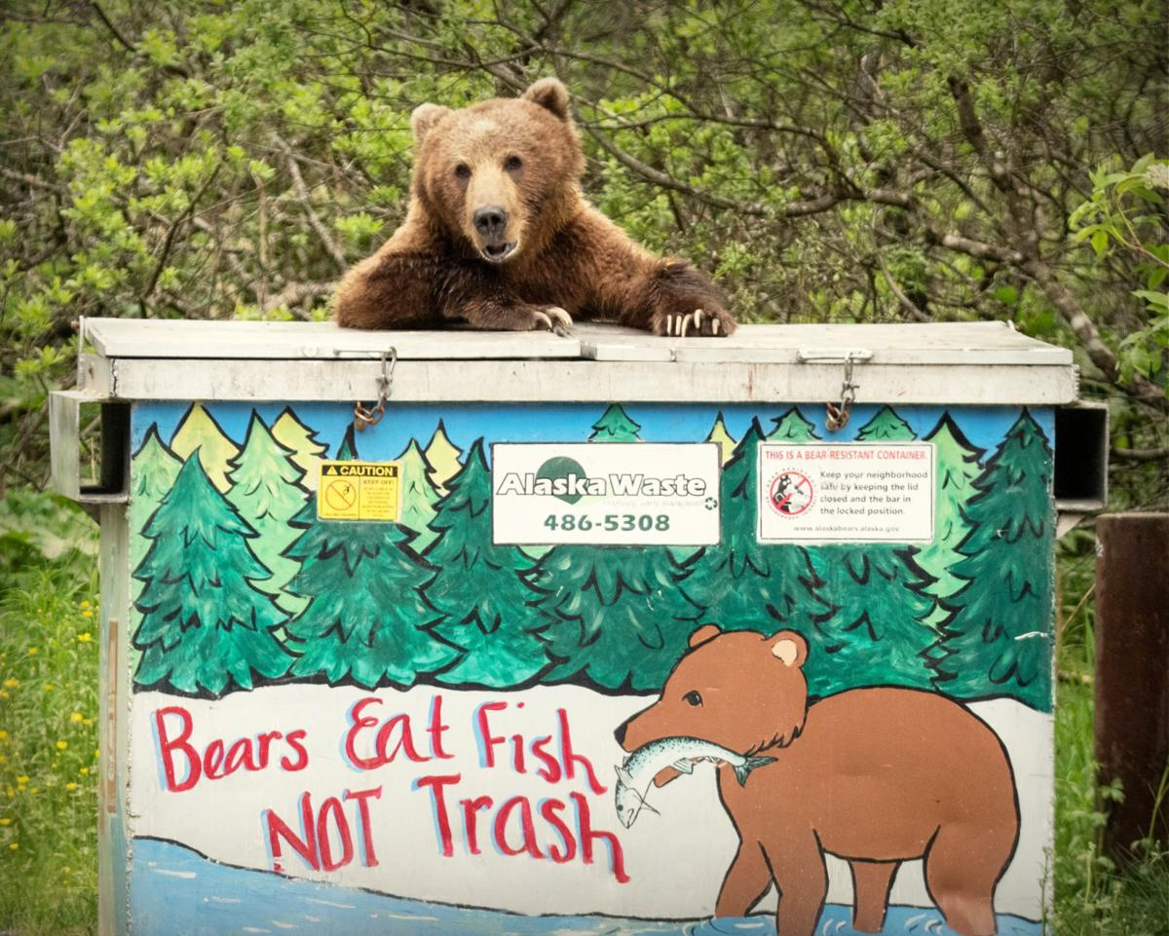
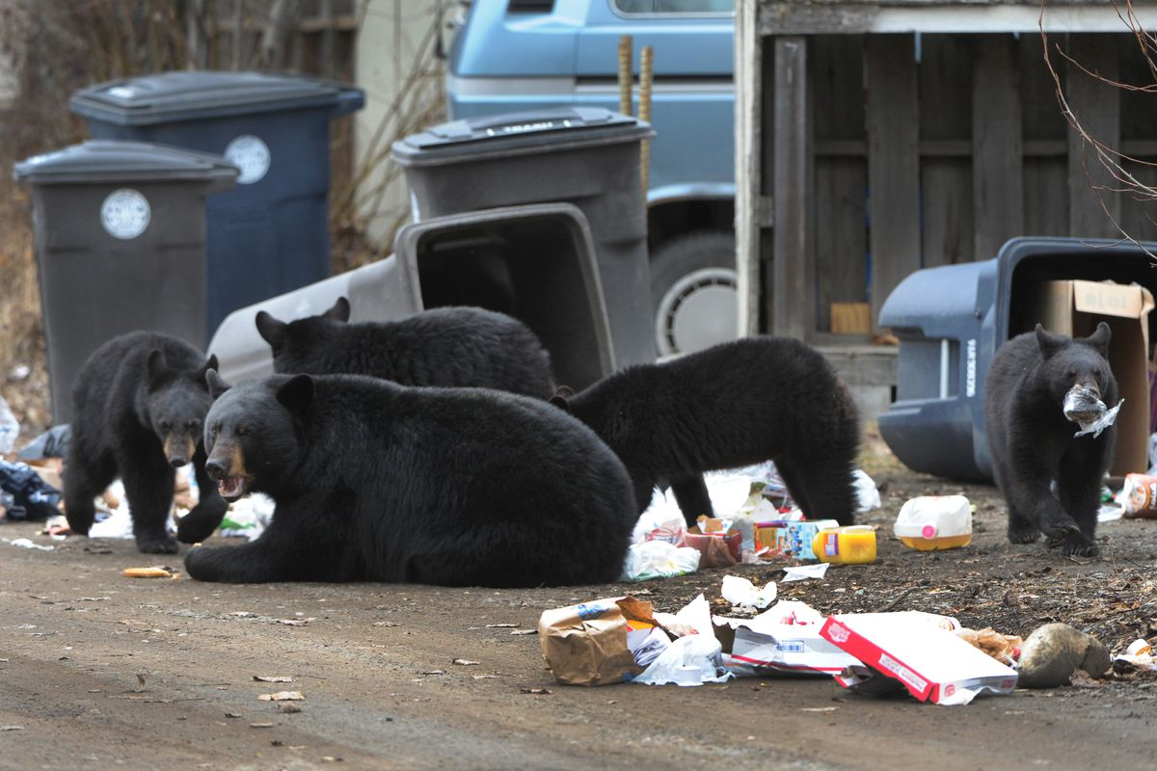
Image Credit: Kodiak Daily Mirror (left) & ADN (right)

Slide 5
Project Parts
Arduino Uno
Mini Solderless Breadboard – 4x4 Points
Standard servo – TowerPro SG-5010
Substitute for more powerful locking mechanism
Water Sensor
RGB LED (K851264)

Slide 6
Arduino Project Demo

Slide 7
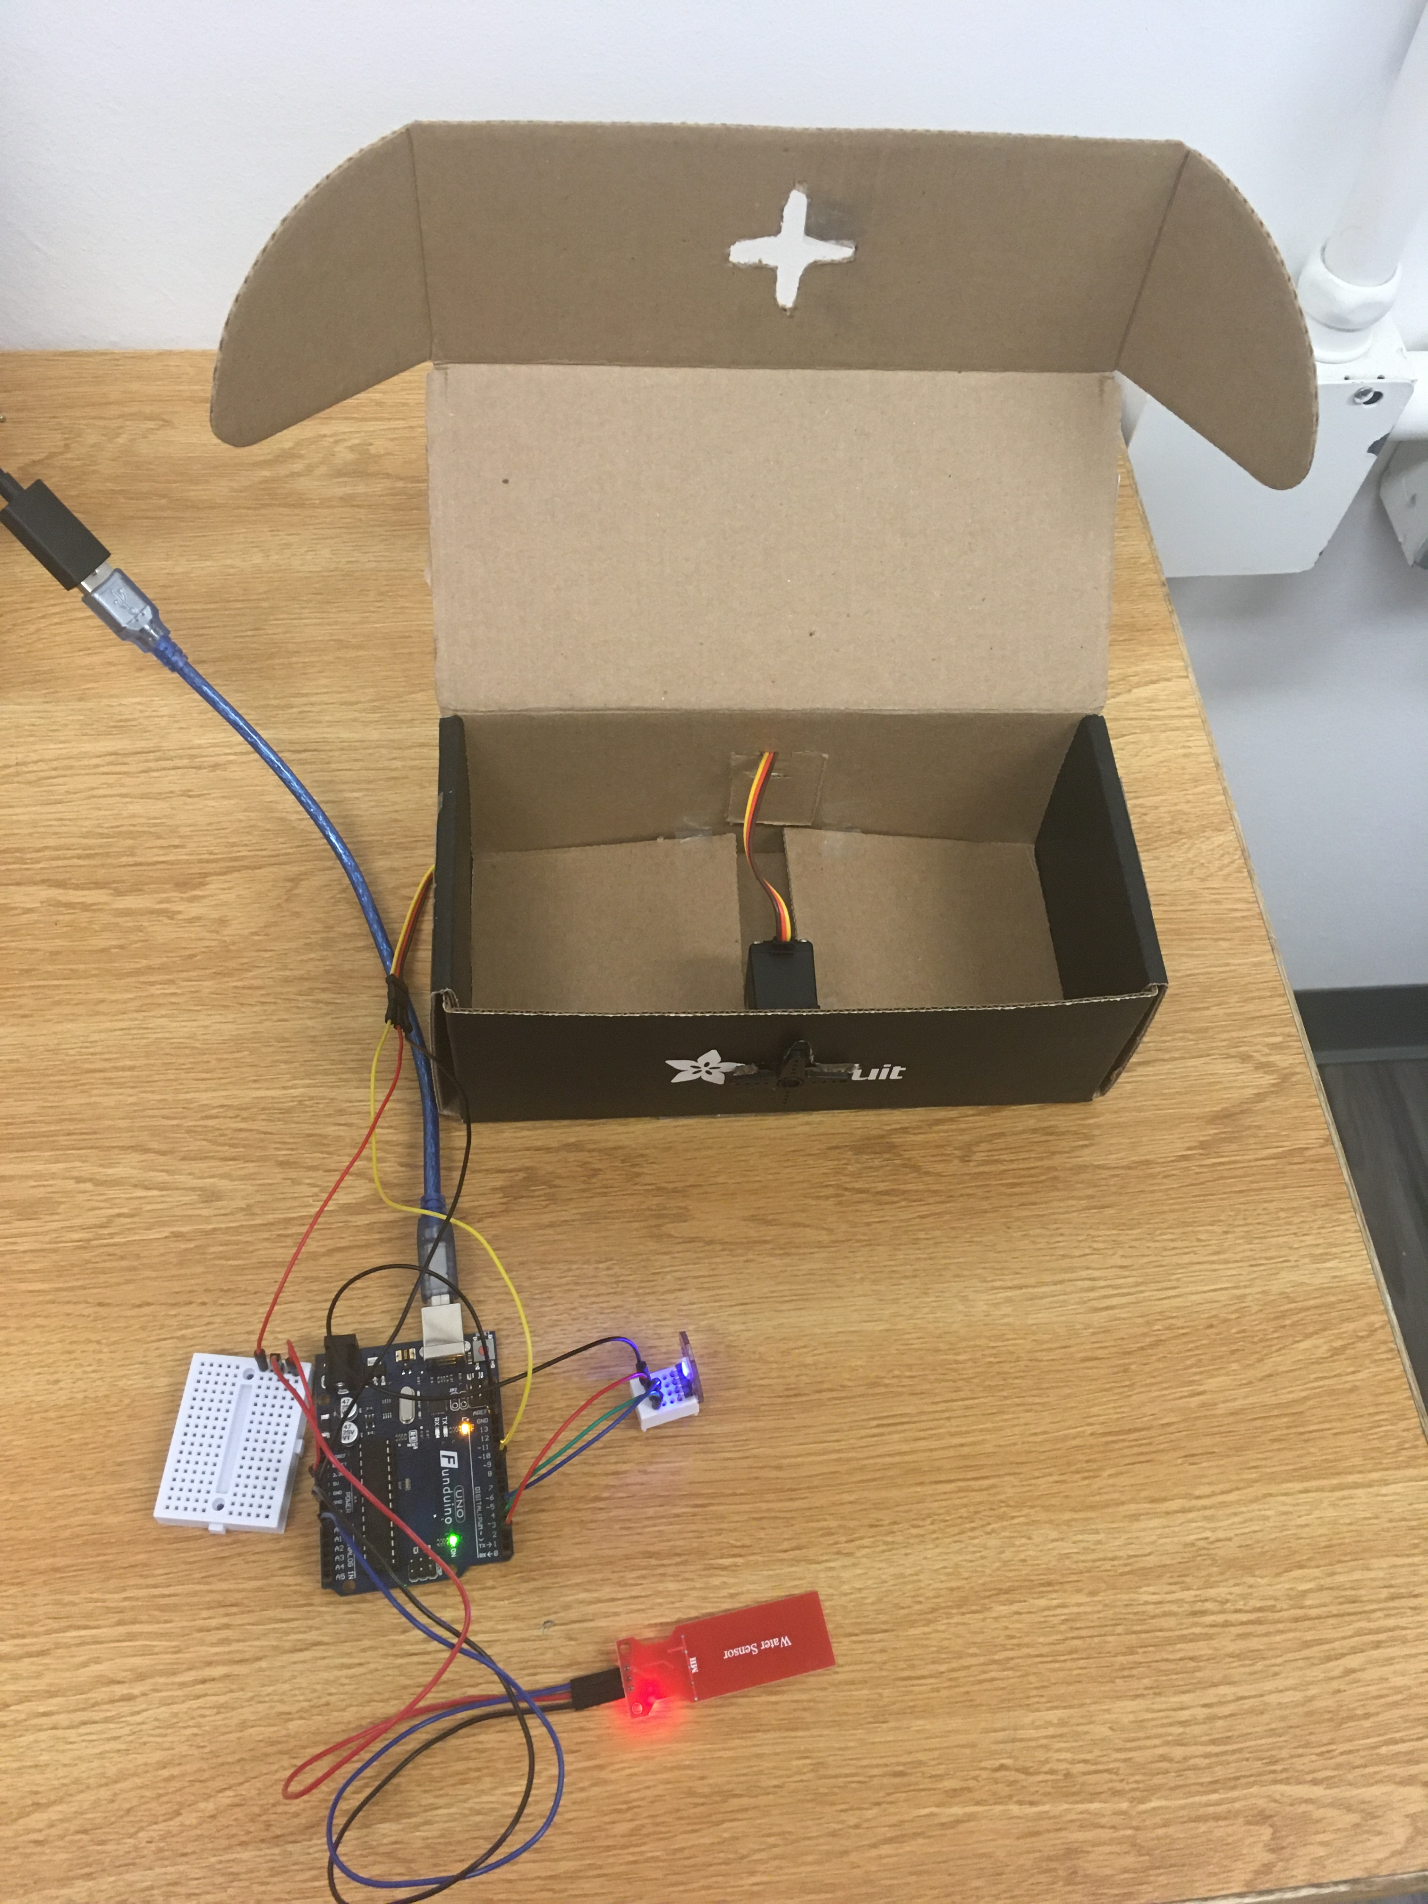
Draft Prototype
Roll cart dimensions
Large pizza box design
“Customized” Adafruit cardboard box

Slide 8
Lessons Learned
Ordering parts
Reading documentation
Interactions between multiple components
Time management
Scope creep

Slide 9
Future Improvements
IFTTT/Twilio SMS integration
Independent power supply
Rechargeable batteries or solar powered
Accelerometer & Magnetometer
STEMMA QT / Quiic JST SH 4-pin Cable
Ordered the wrong part – need male headers ☹
Outdoor weather testing
Cold weather & water limitations

Slide 10
Questions?

